Slide 1


CE343: SOFTWARE ENGINEERING
June 2019 – Nov. 2019
UNIT 9
Introduction to SaaS

Slide 2


Content
Product Lifetime: Independent Product vs Continuous Improvement
Software as a Service
Service Oriented Architecture
Cloud Computing
SaaS Architecture
Unit 9

Slide 3
Product Lifetime: Independent Product vs. Continuous Improvement
There are three assumptions made for product lifetime:
Products have a limited life and thus every product has a life cycle.
Product sales pass through distinct stages, each posing different challenges, opportunities and problems to the seller.
Products require different marketing, financing, manufacturing, purchasing and human resource strategies throughout its lifetime.
Unit 9

Slide 4
There are two important approaches for product lifetime
(1) Independent Product, (2) Continuous Improvement
Quality Management (QM) is an approach to doing business that maximizes the competitiveness of an organization through continuous improvement of its products, services, people, processes, and environments.
The continuous improvement tasks are:
Review product, processes and practices periodically to look for rooms for improvement and efficiency enhancement.
Conduct frequent retrospectives and experiments to continually improve team processes and effectiveness.
Gather feedback from stakeholders on product increments and demonstrations to enhance value delivery.
Develop a team of generalizing specialists by providing learning and practicing opportunities.
Perform value stream analysis on existing processes to remove wastes and improve efficiency.
Disseminate knowledge gained during carrying out the project works to the whole organization for organizational improvement.
Unit 9

Slide 5
Software as a Service
SaaS is often referred to as software-on-demand and utilizing it is akin to renting software rather than buying it.
With traditional software applications you would purchase the software upfront as a package and then install it onto your computer.
The software’s license may also limit the number of users and/or devices where the software can be deployed.
Unit 9

Slide 6
Reasons why SaaS is beneficial
No additional hardware costs; the processing power required to run the applications is supplied by the cloud provider.
No initial setup costs; applications are ready to use once the user subscribes.
Pay for what you use; if a piece of software is only needed for a limited period then it is only paid for over that period and subscriptions can usually be halted at any time.
Usage is scalable; if a user decides they need more storage or additional services, for example, then they can access these on demand without needing to install new software or hardware.
Updates are automated; whenever there is an update it is available online to existing customers, often free of charge. No new software will be required as it often is with other types of applications and the updates will usually be deployed automatically by the cloud provider.
Unit 9

Slide 7
Contd…
Cross device compatibility; SaaS applications can be accessed via any internet enabled device, which makes it ideal for those who use a number of different devices, such as internet enabled phones and tablets, and those who don’t always use the same computer.
Accessible from any location; rather than being restricted to installations on individual computers, an application can be accessed from anywhere with an internet enabled device.
Application can be customized and white labelled; with some software, customization is available meaning it can be altered to suit the needs and branding of a particular customer
Unit 9

Slide 8
Contd…
There are no setup costs with SaaS, as there often are with other applications.
SaaS is scalable with upgrades available on demand.
Access to Software as a Service is compatible across all internet enabled devices.
As long as there is an internet connection, applications are accessible from any location.
Unit 9

Slide 9
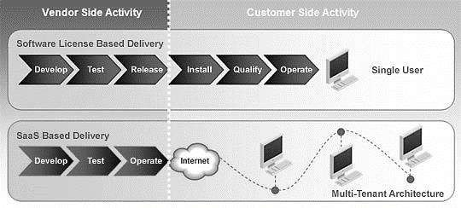
SaaS Architecture
Unit 9

Slide 10
Application Service Providers (ASPs) basically allowed their customers to download software applications and the installation process was similar to the traditional CD-based software.
Even though the ASP service model provided a relatively efficient means of getting software applications to the customer, it suffered a number of problems.
The main one being the size of the actual download file, which could run into hundreds of MB; and the subsequent maintenance updates which also had to be downloaded on a regular basis.
Without these updates the software vendors could not always ensure that their customers were running the latest version of their software.
Unit 9

Slide 11
In essence, all users of SaaS-based applications run exactly the same code with customizations and configurations stored as metadata parameters.
The key difference between SaaS and traditional software delivery is that SaaS-based applications are fully hosted within some form of data Centre environment.
All updates to the SaaS application are carried out within the data Centre and therefore the user can always be assured that they are using the most recent version of the application.
These applications are designed from the ground up to work and take advantage of operating within a web browser-based environment.
Unit 9

Slide 12
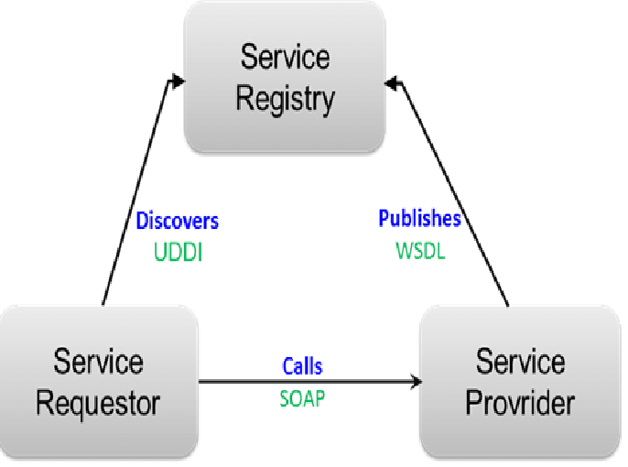
Service Oriented Architecture
Unit 9

Slide 13
Service-oriented architecture (SOA) is a style of software design where services are provided to the other components by application components, through a communication protocol over a network. The basic principles of service-oriented architecture are independent of vendors, products and technologies.
A service is a discrete unit of functionality that can be accessed remotely and acted upon and updated independently, such as retrieving a credit card statement online.
A service has four properties according to one of many definitions of SOA:
It logically represents a business activity with a specified outcome.
It is self-contained.
It is a black box for its consumers.
It may consist of other underlying services.
Unit 9

Slide 14
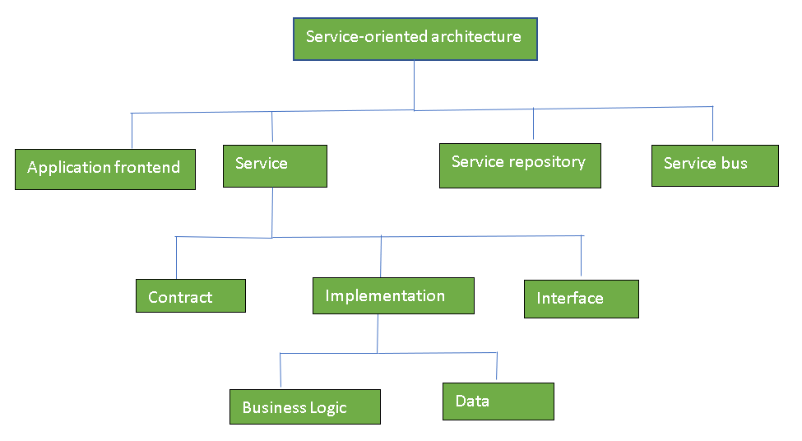
Components of SOA
Unit 9

Slide 15
General Principles of SOA
Standardized service contract: Specified through one or more service description documents.
Loose coupling: Services are designed as self-contained components, maintain relationships that minimize dependencies on other services.
Abstraction: A service is completely defined by service contracts and description documents. They hide their logic, which is encapsulated within their implementation.
Reusability: Designed as components, services can be reused more effectively, thus reducing development time and the associated costs.
Unit 9

Slide 16
Contd…
Autonomy: Services have control over the logic they encapsulate and, from a service consumer point of view, there is no need to know about their implementation.
Discoverability: Services are defined by description documents that constitute supplemental metadata through which they can be effectively discovered. Service discovery provides an effective means for utilizing third-party resources.
Composability: Using services as building blocks, sophisticated and complex operations can be implemented. Service orchestration and choreography provide a solid support for composing services and achieving business goals.
Unit 9

Slide 17
Advantages of SOA
Service reusability: In SOA, applications are made from existing services.Thus, services can be reused to make many applications.
Easy maintenance: As services are independent of each other they can be updated and modified easily without affecting other services.
Platform independent: SOA allows making a complex application by combining services picked from different sources, independent of the platform.
Availability: SOA facilities are easily available to anyone on request.
Reliability: SOA applications are more reliable because it is easy to debug small services rather than huge codes
Scalability: Services can run on different servers within an environment, this increases scalability
Unit 9

Slide 18
Disadvantages of SOA
High overhead: A validation of input parameters of services is done whenever services interact this decreases performance as it increases load and response time.
High investment: A huge initial investment is required for SOA.
Complex service management: When services interact they exchange messages to tasks. the number of messages may go in millions. It becomes a cumbersome task to handle a large number of messages.
Unit 9

Slide 19
Applications of SOA
SOA infrastructure is used by many armies and air force to deploy situational awareness systems.
SOA is used to improve the healthcare delivery.
Nowadays many apps are games and they use inbuilt functions to run. For example, an app might need GPS so it uses inbuilt GPS functions of the device. This is SOA in mobile solutions.
SOA helps maintain museums a virtualized storage pool for their information and content.
Unit 9

Slide 20
What is Cloud Computing?
The "cloud" is a set of different types of hardware and software that work collectively to deliver many aspects of computing to the end-user as an online service.
Cloud Computing is the use of hardware and software to deliver a service over a network (typically the Internet). With cloud computing, users can access files and use applications from any device that can access the Internet.
An example of a Cloud Computing provider is Google's Gmail. Gmail users can access files and applications hosted by Google via the internet from any device.
Unit 9

Slide 21
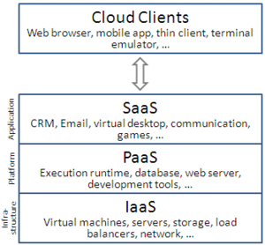
Unit 9

Slide 22
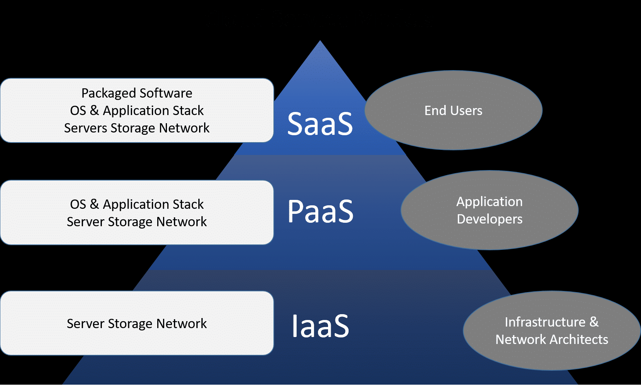
Cloud Service Models
Unit 9

Slide 23
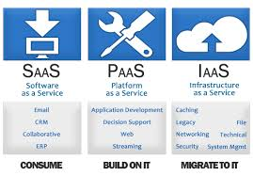
Unit 9

Slide 24


